Slide 1
Employee Data Analysis using Excel
STUDENT NAME: DHASHANA.R
REGISTER NO: 312215906
DEPARTMENT:B.COM ACCOUNTING AND FINANCE
COLLEGE: SHRI SHANKARLAL SUNDARBAI SHASUN JAIN COLLEGE FOR WOMENS

Slide 2
PROJECT TITLE
Employee Performance Analysis using Excel

Slide 3


AGENDA
Problem Statement
Project Overview
End Users
Our Solution and Proposition
Dataset Description
Modelling Approach
Results and Discussion
Conclusion
3/21/2024 Annual Review

Slide 4

PROBLEM STATEMENT
Here's a potential problem statement for employee performance analysis:
Our organization struggles to accurately and consistently evaluate employee performance, leading to inconsistent promotions, inaccurate salary adjustments, and inadequate training and development opportunities. We need a comprehensive and data-driven approach to analyze employee performance, identify areas of strength and weakness, and provide actionable insights to support informed decision-making and drive business growth.

Slide 5

PROJECT OVERVIEW
This project overview provides a general outline of the project's objectives, scope, deliverables, timeline, stakeholders, resources, and budget. It can be tailored to fit the specific needs and requirements of your organization.
Excel is a versatile tool that can be used to effectively analyze employee performance data. By leveraging its functions and capabilities
Common Excel Functions Used in Employee Performance Analysis :
AVERAGE: Calculates the average value of a range of cells.
COUNTIF: Counts the number of cells within a range that meet a specified criterion.
SUMIF: Adds up the values in a range that meet a specified criterion.
VLOOKUP: Looks up a value in the first column of a table and returns the corresponding value from a specified column.

Slide 6

WHO ARE THE END USERS?
HR Generalists/Analysts: Responsible for implementing and managing the performance evaluation process, analyzing data, and providing insights to support talent development and management decisions.
Managers/Supervisors: Use the system to evaluate employee performance, provide feedback and coaching, and make informed decisions about promotions, salary adjustments, and training needs
Employees: Utilize the system to understand their performance expectations, receive feedback and coaching, and track their progress and development
Senior Leaders/Executives: Leverage the system to gain visibility into organizational performance, identify talent gaps, and make strategic decisions about resource allocation and talent development.

Slide 7

WHO ARE THE END USERS?
5.Talent Development/Training Professionals: Use the system to identify training needs, design targeted development programs, and measure the effectiveness of training initiatives.
6. Compensation and Benefits Professionals: Utilize the system to inform salary adjustments, bonuses, and other compensation decisions.
7. Succession Planning Professionals: Use the system to identify and develop future leaders, and create succession plans.
8. Diversity, Equity, and Inclusion (DEI) Professionals: Leverage the system to analyze and address potential biases in performance evaluations and talent development decisions.

Slide 8

OUR SOLUTION AND ITS VALUE PROPOSITION
Conditional formatting: for finding out the missing values in given databases
Filters: Manages large datasets, enabling you to focus on specific segments of data and make informed decisions based on the filtered results.
Formulas: Performs a wide range of tasks from basic arithmetic to complex data analysis to analyze data, automate tasks, and make informed decisions
.

Slide 9
OUR SOLUTION AND ITS VALUE PROPOSITION
PivotTables: Powerful tools for data analysis that allow you to summarize, analyze, explore, and present data in various ways. It allows you to easily reorganize and summarize selected columns and rows of data to obtain the desired report without altering the original data.
Graphs: Represent data in a graphical format, making it easier to understand patterns, trends, and relationships in your data. Depending on the nature of your data and the kind of analysis you can choose the graph.

Slide 10
Dataset Description
* Employee data set taken from the KAGGLE.
* In dataset , out of 26 data I took only 9 features out of it.
*The selected 10 features are listed below :
1.Employee ID
2.First name
3.Last name
4.Business unit
5.Employee type

Slide 11
Dataset Description
6.Employee status
7.Employee classification type
8.Gender Code
9.Performance score
10.Current employee rating

Slide 12

THE "WOW" IN OUR SOLUTION
Accurate and Consistent Evaluations
2. Data-Driven Decision-Making
3.Improved Employee Engagement and Development
4.Enhanced Managerial Effectiveness
5. Streamlined Performance Management Processes
6. Better Alignment with Organizational Objectives
7. Identified Talent Gaps and Succession Planning
8. Unbiased and Fair Performance Evaluations
3/21/2024 Annual Review
12

Slide 13
MODELLING
DATA COLLECTION :The data has been collected through Edunet dash board.
FEATURE COLLECTION :The listed 10 features were taken for the analyses of data.
DATA CLEANING : Identifying the missing values . Filtering of those missing values.
CALCULATION OF PERFORMANCE : considering the current employee rating, found the performance level using the formula.
SUMMARY OF PIVOT LEVEL :Segregating od certain features to rows, columns, heading and so on.
VISUALIZATION : Once completed with pivot table, created the graph for precise visualization.
13

Slide 14
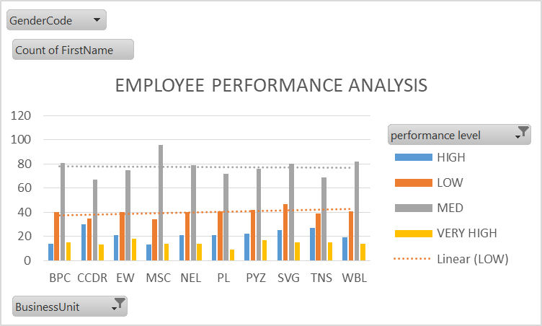
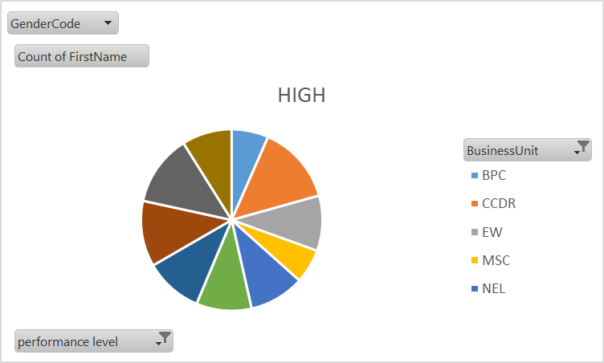
RESULTS
EMPLOYEE PERFORMANCE ANALYSIS
14

Slide 15
conclusion
Effective employee performance analysis is crucial for driving business success, improving talent management, and enhancing organizational competitiveness. By implementing a comprehensive performance analysis system, organizations can:- Accurately evaluate employee performance and potential- Identify areas for growth and development- Inform data-driven talent management decisions- Enhance employee engagement and retention- Align performance with organizational objectives

Slide 16
Thank you

